Slide 1
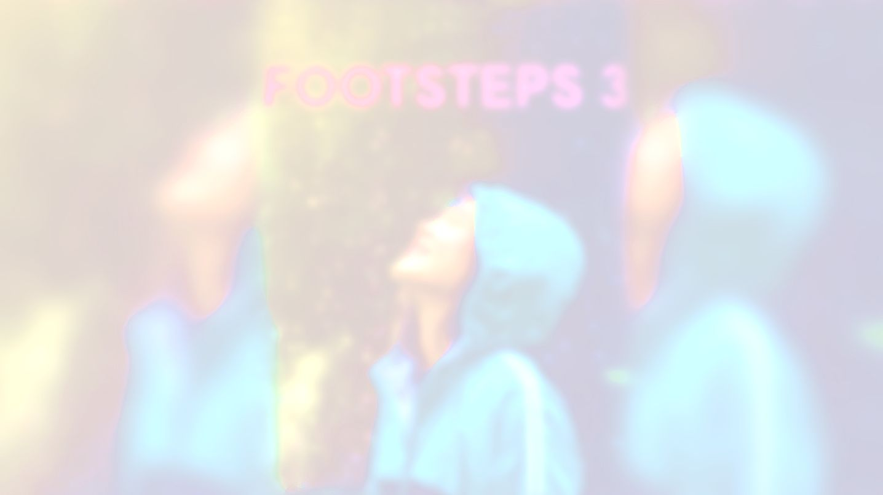

UNIT 1;
With you from the start
Chalk and cheese

Slide 2
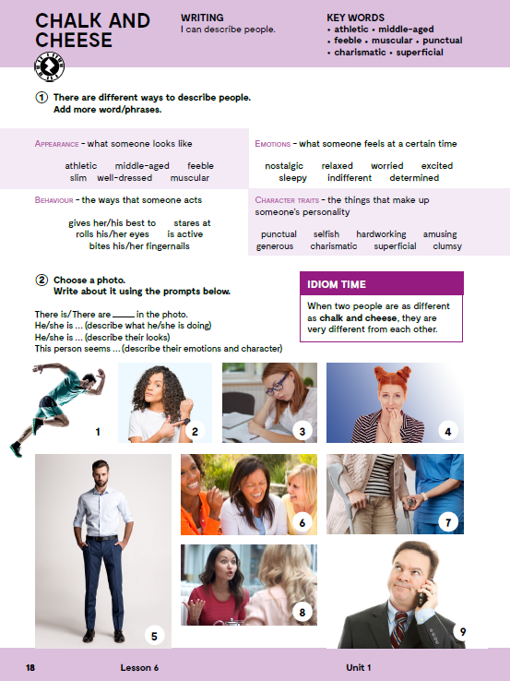
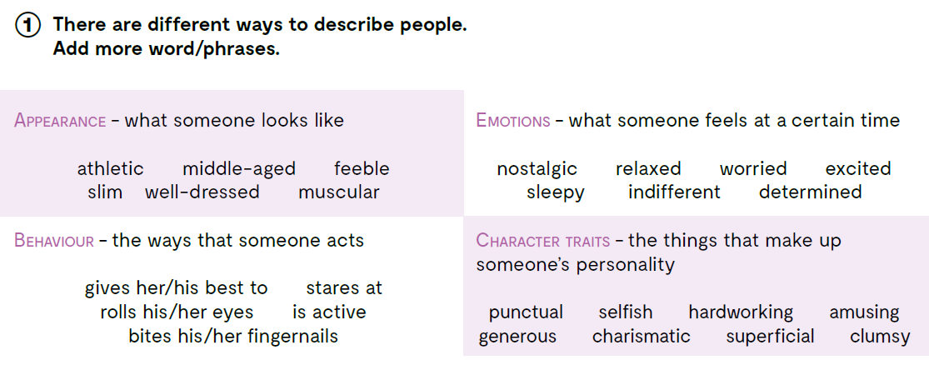

Slide 3
APPEARANCE
athletic
middle-aged
feeble
slim
well-dressed
muscular
PONAŠANJE
daje sve od sebe
piljiti u
preokreće očima
je aktivan/aktivna
grize nokte
VANJSKI IZGLED
atletski građen
srednjih godina
nježan, slab
vitak
lijepo odjeven
mišićav
BEHAVIOUR
gives her/her best to
stares at
rolls his/her eyes
is active
bites his/her fingernails
CHARACTER TRAITS
punctual
selfish
hardworking
amusing
generous
charismatic
superficial
clumsy
KARAKTERNE OSOBINE
točan
sebičan
vrijedan
zabavan
velikodušan
karizmatičan
površan
nespretan
EMOTIONS
nostalgic
relaxed
worried
excited
sleepy
indifferent
determined
OSJEĆAJI
nostalgičan
opušten
zabrinut
uzbuđen
pospan
ravnodušan
odlučan

Slide 4
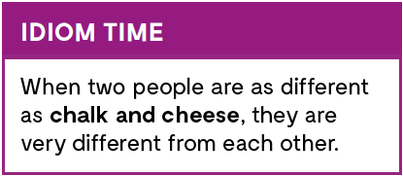
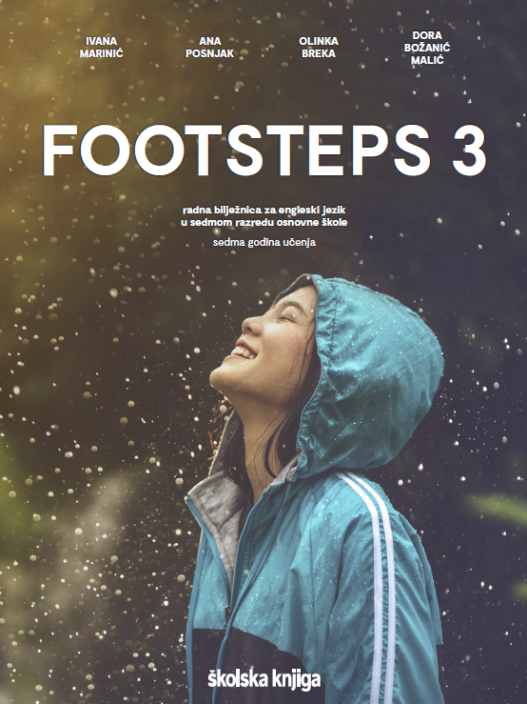
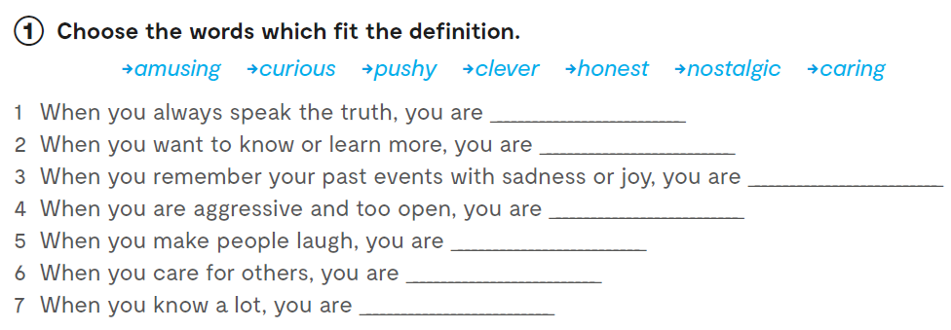
Workbook, page 15.
honest
curious
nostalgic
pushy
amusing
caring
clever

Slide 5
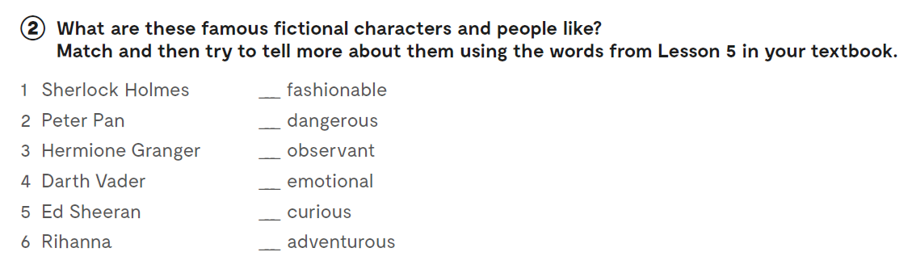
6
4
1 pažljiv, pronicljiv
5
3
2

Slide 6
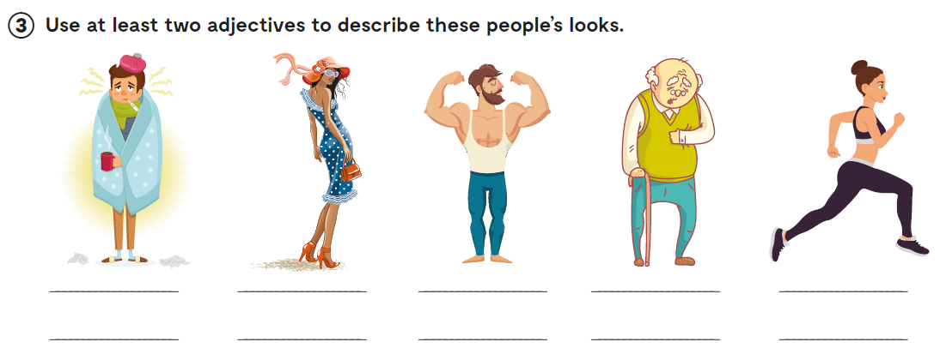
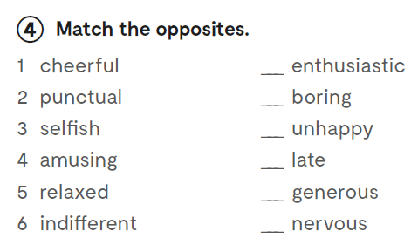
young, slim
6
4
1
2
3
5

Slide 7
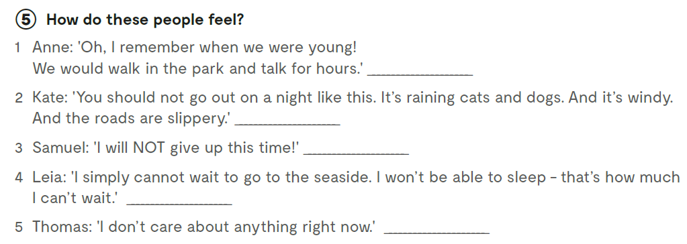
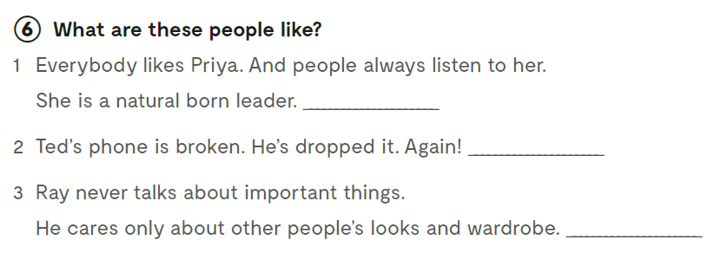
nostalgic
worried
determined
excited
indifferent
charismatic
clumsy
superficial

Slide 8

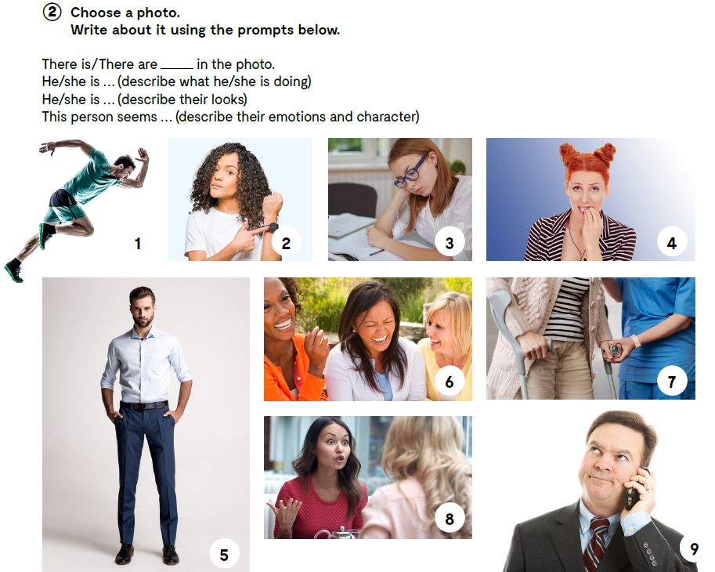
There is a man in the photo.
He is running.
He is muscular and athletic.
This person seems excited, determined and hardworking.
Let’s practise!
https://learningapps.org/watch?v=pxbsks96t20

Slide 9

LEARN MORE!
https://www.e-sfera.hr/dodatni-digitalni-sadrzaji/ad6bdda6-8715-4891-97c7-fc25b9bcab20/
How to describe people well, useful tips
Choose one or more of the suggestions and describe someone in class without mentioning their name. Don’t use more than 100 words.

Slide 10
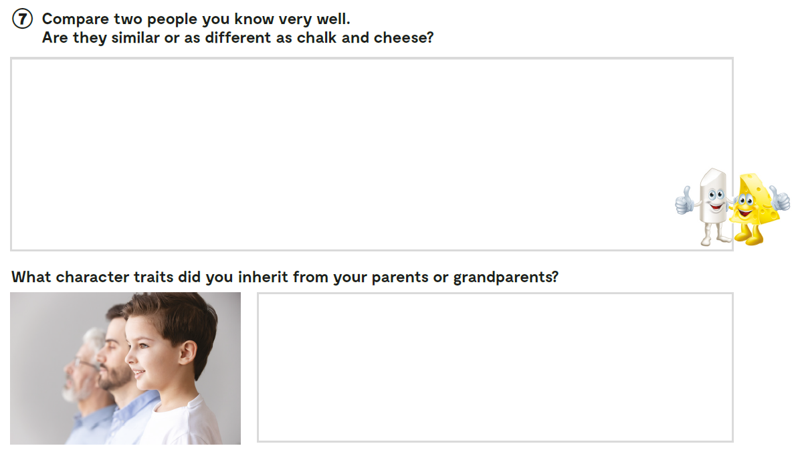
Workbook, page 16.

